Slide 1
Virtual-Memory Management
Benefits of Virtual Memory
Demand Paging
Principle of Working-set Model
Shared memory and Memory-mapped files
How to manage Kernel memory

Slide 2

Allocation of Frames
How do we allocate the fixed amount of free memory among the processes?
Simplest case of frame allocation in a single- user system
Variants include maintaining a few free frames by the OS all the time
Minimum Number of Frames
OS must allocate at least a minimum number of frames to a process
Performance of the process is affected
Page fault rate is directly proportional to the number of frames allocated to a process

Slide 3
Allocation of Frames
A process should have enough frames to hold all the pages that a single instruction can reference
This is defined by the computer architecture
Move instruction of Intel 80x86
Worst-case scenario is in architectures that allow multiple levels of indirection
Maximum number of frames allocated to a process is defined by the available physical memory
Allocation Algorithms
Equal allocation
m frames are split among n processes
Give all processes equal share of m/n frames
A few frames are placed in the free buffer pool

Slide 4
Frame Allocation Algorithms
Proportional allocation
Allocate the available physical memory to each process according to its size
Let size of virtual memory for p_{i} be s_{i} and define
S = ∑s_{i}
If the total available frames is m and a_{i} frames are allocated to p_{i} where
a_{i} = s_{i}/S x m, Each a_{i} is adjusted to be an integer
In both equal and proportional allocations, allocated frames vary according to the level of multiprogramming
High priority processes are treated equally with low-priority processes
A solution can be that a process is allocated frames as a combination of its size and priority

Slide 5
Global versus Local Allocation
Categories of page replacement algorithms
Global replacement
Allows a process to select a replacement frame from a set of all frames even if the frame is allocated to another process
Frames allocated to a process may increase
A process cannot control its own page-fault rate
Local replacement
Each process selects from its own allocated set of frames
Frames allocated to a process does not change
Global replacement generally results in greater system throughput
More commonly used method

Slide 6
Global versus Local Allocation
Implementation of global-replacement policy
Trigger page replacement when the free list of frames falls below a certain threshold
A kernel routine is triggered
Begins reclaiming pages from all processes in the system
Reapers use any replacement policy
When the amount of free memory reaches a maximum threshold
Reaper routine is suspended
Values of minimum and maximum threshold can be defined in implementations
Can be a default value or set by the administrator

Slide 7
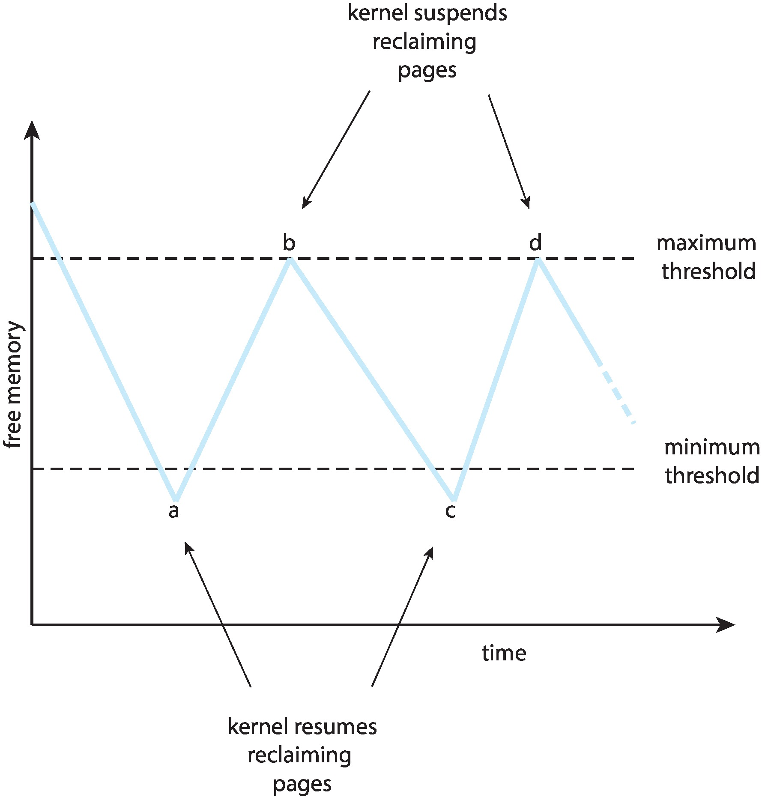
Reclaiming Pages

Slide 8
Major and Minor page faults
Two types of page faults
Major and minor page faults
Referred to hard and soft faults in Windows
Major page faults
Occurs when a page is referred and is not in memory
Same steps are taken as in a page fault
Minor page fault
Occurs when a process does not have a logical mapping to a page that is present in memory
There are two reasons of minor page faults

Slide 9
Major and Minor page faults
Process refers to a shared library that is in memory
Process does not have a mapping to it in its page table
Page is reclaimed from a process and the page is placed in the free frame list
Page is not yet allocated to another process
Minor page faults consume much less time than major page faults
Number of minor page faults are larger than major page faults

Slide 10
Thrashing
If a process does not have ‘enough’ frames
It page-faults more frequently as compared to performing useful computation
A process is thrashing if it spends more time in paging than executing
A high paging activity
Thrashing gives rise to severe performance problem
Cause of Thrashing
Thrashing of a process gives rise to overall reduction in CPU utilization
Global replacement algorithm aggravates the situation even further
The effects of thrashing can be limited by using local replacement algorithm

Slide 11
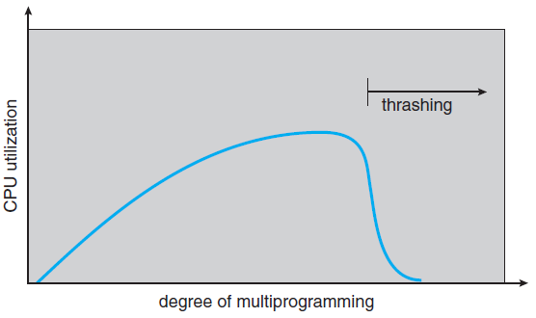
Thrashing
Notes:
11

Slide 12
Thrashing
Prevent thrashing by providing a process with as many frames as it needs
How is this number estimated?
One strategy is to observe how many frames is a process actually using
This approach defines the locality model of process execution
As a process executes, it moves from locality to locality
A locality is a set of pages that are actively used together
A program consists of several different localities that may overlap
All programs show locality in their memory reference patterns

Slide 13
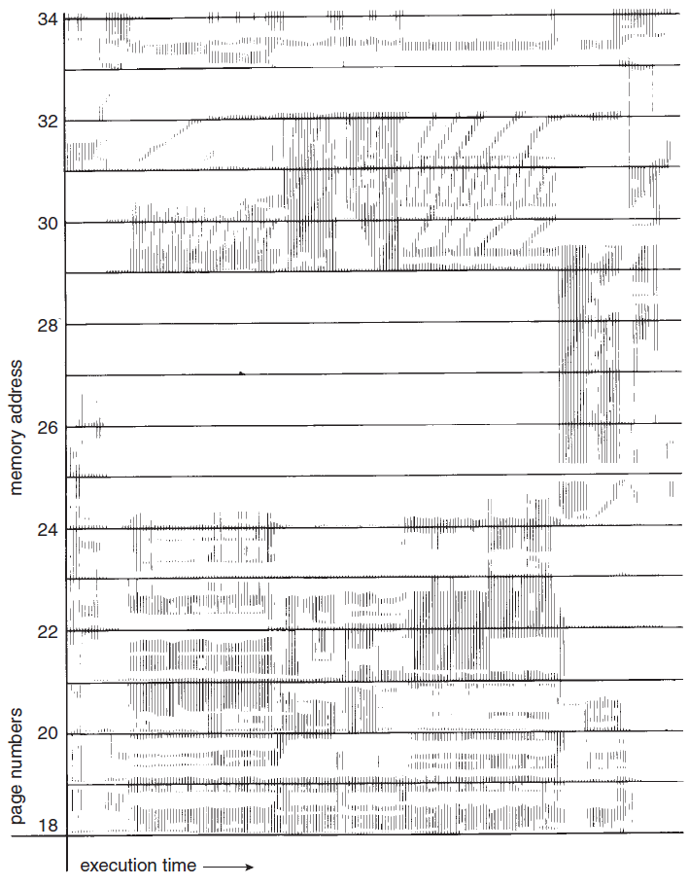
Locality In A Memoryreferen-ce Pattern
Notes:
13

Slide 14
Locality In A Memoryreferen-ce Pattern
a
b
At time a – locality is the set of pages
{18, 19, 20, 21, 22, 23, 24, 29, 30, 33}
At time b – locality is the set of pages
{18, 19, 20, 24, 25, 26, 27, 28 29, 31, 32, 33}
Notes:
14

Slide 15
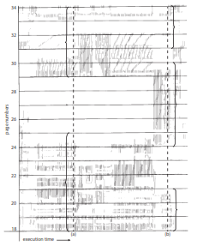
Locality In A Memoryreferen-ce Pattern
At time a – locality is the set of pages
{18, 19, 20, 21, 22, 23, 24, 29, 30, 33}
At time b – locality is the set of pages
{18, 19, 20, 24, 25, 26, 27, 28 29, 31, 32, 33}
Notes:
15

Slide 16
Working-Set Model
Working-set model is based on the assumption of locality
A parameter Δ is used to define the working- set window
The set of pages in the most recent Δ page references is the working set
A page which is in active use would be a part of the working set
An approximation of program’s locality
The accuracy of working set depends on the selection of the parameter Δ
If we compute the working set size WSS_{i} for each process
D = ∑ WSS_{i}
where D is the total demand for frames

Slide 17
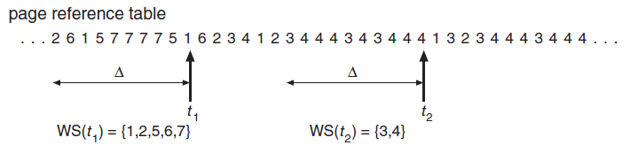
Working-set Model
Notes:
17

Slide 18
Working-Set Model
If D > m, thrashing will occur
Process monitoring is simple with selection of Δ
Suspension may take place to prevent thrashing
Optimum degree of multiprogramming
Working-set strategy prevents thrashing
It optimizes CPU utilization
Problem is to keep track of the working set
Working-set window is a moving window
Working-set model can be approximated by using a fixed-interval timer interrupt and a reference bit
This is not an accurate method
Increase the accuracy by increasing the number of history bits and the frequency of interrupts

Slide 19
Page-Fault Frequency
A more direct approach to control thrashing is to use page-fault frequency (PFF)
If the page fault rate is too high, the process needs more frames
If the page-fault rate is too low, the process may have too many frames
An upper and lower bound can be established on the desired page-fault rate
Measure and control the page-fault rate directly to prevent thrashing
A process is selected for suspension if the page-fault rate increases beyond the upper bound and no free frames are available
Current practice is to provide enough memory to avoid thrashing and reduce page fault rate

Slide 20
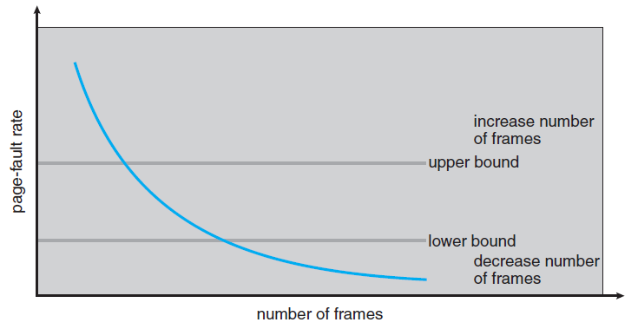
Page-Fault Frequency Scheme
Notes:
20

Slide 21
Memory Compression
Compression is an alternative to paging
Compress several frames into a single frame
Reduce memory usage without swapping
How does compression work?
Most mobile operating systems use compression as a memory management strategy
Faster than paging on laptops and macOS systems
Compression ratio
Ratio of speed of compression algorithm and the amount of reduction
Higher compression ratio can be achieved by slower, more computationally expensive algorithm
Balance should be maintained

Slide 22
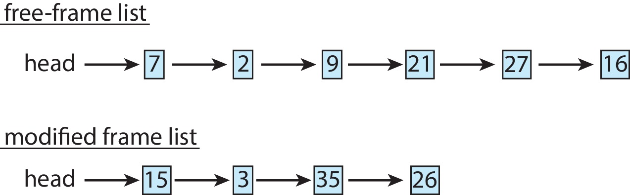
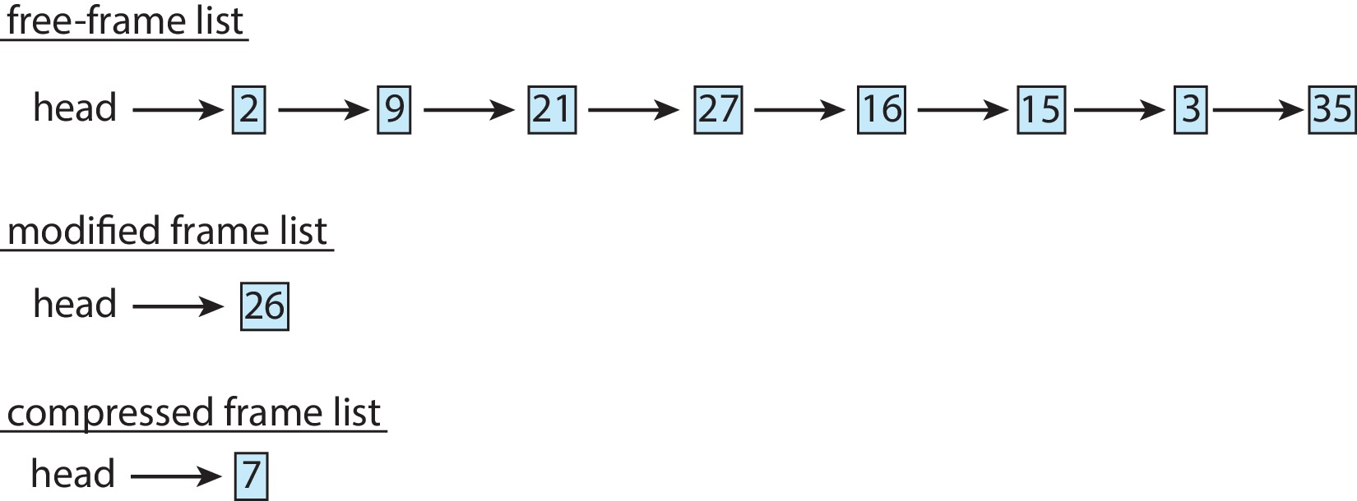
Memory Compression

Slide 23
Allocating Kernel Memory
Free memory assigned to kernel is contiguous in the physical address space
It is not subjected to paging
Reasons
Kernel must use memory conservatively minimizing wastage due to fragmentation
Certain hardware devices interact directly with the physical memory
May require memory residing in physically contiguous pages
There are two strategies for managing free memory assigned to kernel processes

Slide 24
Allocating Kernel Memory
Buddy system
Allocates memory from a fixed-size segment consisting of physically contiguous pages
Power-of-2 allocator
Operation of buddy system
Advantage of buddy system : Fast coalescing technique where adjacent buddies can be combined to form larger segments
Disadvantage: Internal fragmentation takes place within allocated segments
Slab Allocation
Another strategy for allocating kernel memory
A slab is made up of one or more physically contiguous pages

Slide 25
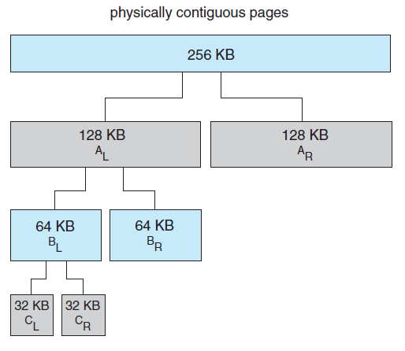
Buddy System Allocation
Notes:
25

Slide 26
Allocating Kernel Memory
A cache consists of one or more slabs
There is a single cache for each unique kernel data structure
Each cache is populated with objects that are instantiations of the kernel data structure the cache represents
The slab-allocation algorithm uses caches to store kernel objects
When a cache is created, a number of objects are allocated to the cache
The number of objects in the cache depends on the size of the associated slab
Free and used objects in a slab
Example of slab allocation for an object in Linux

Slide 27
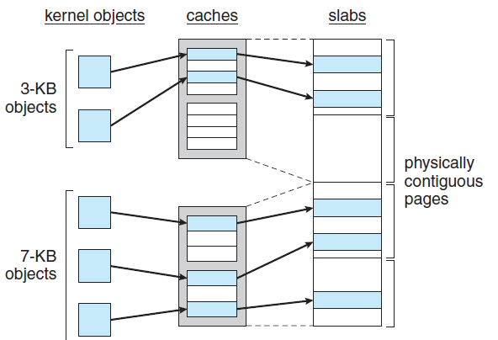
Slab Allocation
Notes:
27

Slide 28
Allocating Kernel Memory
A slab may be in one of three states in Linux
Full
All objects in the slab are marked as used
Empty
All objects in the slab are marked as free
Partial
The slab consists of both used and free objects
Benefits of slab allocator
No memory is wasted due to fragmentation
Allocator returns the exact amount of memory required to represent the object
Memory requests can be satisfied quickly
Slab allocator is used in Solaris and Linux

Slide 29
Allocating Kernel Memory
SLOB and SLUB allocators
Included in recent distributions of Linux
SLOB allocator (Simple List of Blocks)
Designed for systems with limited memory
Maintains three lists of objects
Small, medium and large
Uses first-fit policy to allocate memory from the list of blocks
SLUB allocator has replaced the default slab allocator from Linux V2.6.24
Reduces overhead required by the slab allocator
Provides better performance as the number of processors increase

Slide 30
Other Considerations for Paging
Selection of a replacement algorithm and an allocation policy is central to paging systems
Other considerations are also important for performance
Prepaging
A strategy that is used to prevent a large number of initial page faults
Bring into memory all the pages that will be needed at one time
Systems using working-set model keep a list of pages in its working set
A process when suspended remembers its working set
Before restarting the process, its entire working set is brought into memory

Slide 31
Other Considerations
Prepaging may offer advantage in some cases
Determine whether the cost of using prepaging is less than the cost of servicing the page faults
If s pages are prepaged and only a fraction α is used where 0 ≤ α ≤ 1, then
If α is close to 0, prepaging loses
If α is close to 1, prepaging wins
Page Size
One of the design choices made at the time of processor design is selection of a page size
What should be the size of a page?
There is no single best page size

Slide 32
Other Considerations
Smaller page size
Advantages
Memory is more efficiently utilized because of less internal fragmentation
Smaller page size matches program locality more accurately
Total I/O is reduced
Better resolution is achieved allowing to isolate only the needed memory
Disadvantages
Smaller page size results in a larger page table
Frequency of I/O increases
Number of page fault increases

